Slide 1


The Daily Grind
Café Shop Management System
CSE 430

Slide 2
Group members:
Course Instructor
Prof. Dr. Shamim H Ripon
Department Of Computer Science and Engineering
East West University
Shafika Sikandar
Id: 2019-3-60-057 (Section-1)
01
Prianka Sarker
Id: 2019-3-60-076
(Section-1)
02
Md. Asif Imtiyaj Chowdhury
Id: 2019-3-60-115 (Section-2)
03

Slide 3
Features of our Project:
1. Login System
2. Admin Panel
3. Employee Panel
4. Ordering System
5. Take orders
6. Display menu
7. Create account
8. Delete account
9. View profile
10. About Section
11. Search Item
12. Order Preview
13. Feedback Section
14. Show Location
15. Online Booking System
16. Discount management
17. Cart Section
18. Order Management
19. Stock Management
20. Manage Product (Add, Delete, Update)
21. Show Bill
22. Display Total Sales Reports
23. Manage Account (Customer, employee)

Slide 4
Functional Requirements of our project:
1. A system must have authentication options like admin, user, and visitor.
2. A system should add, modify, and delete the product.
3. A system should charge the customer for the service when a certain action is completed.
4. A system should be able to create an account, modify it, and delete it.
5. A system should be able to maintain employee details which includes add, view and delete actions.
6. A system should maintain customer details such as name, phone no, address and last order date, number of orders etc.
7. A system should be able to store the order details, such as the place order, view the order, and modify the order status.
8. A system needs to print the bill and store it for an audit trail.
9. A system must be able to search and sort items according to the user preference or product category.
10. A system should receive feedback from the customer.

Slide 5
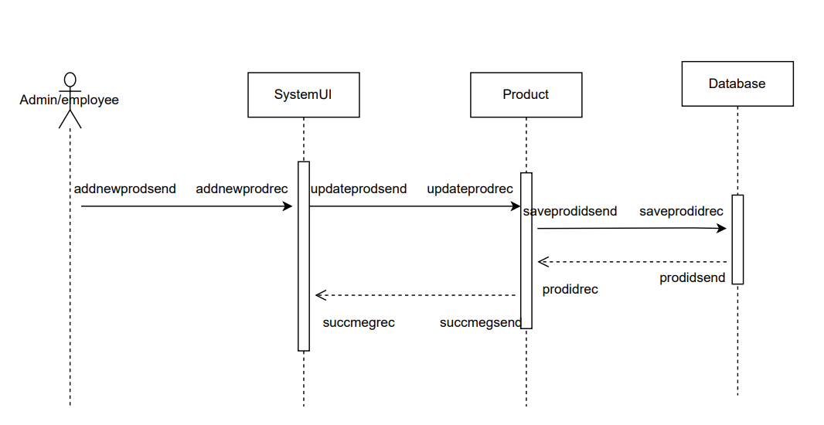
6. A system should maintain customer details such as name, phone no, address and last order date, number of orders etc. 7. A system should be able to store the order details, such as the place order, view the order, and modify the order status. 8. A system needs to print the bill and store it for an audit trail. 9. A system must be able to search and sort items according to the user preference or product category. 10. A system should receive feedback from the customer. 1. Sequence Diagram
1.1. Manage Product Sequence Diagram(Relabeled):

Slide 6
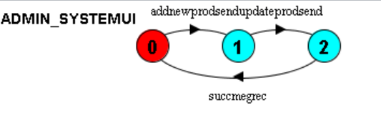
LTS code
1)ADMIN =(addnewprodsend->ADMIN).
SYSTEMUI=(addnewprodrec->updateprodsend->succmegrec->SYSTEMUI).
||ADMIN_SYSTEMUI = (ADMIN ||SYSTEMUI )
/{addnewprodsend/addnewprodrec}.

Slide 7
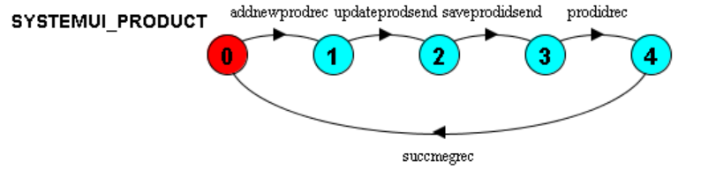
LTS code
2)SYSTEMUI=(addnewprodrec->updateprodsend->succmegrec->SYSTEMUI).
PRODUCT=(updateprodrec->saveprodidsend->prodidrec->succmegsend->PRODUCT).
||SYSTEMUI_PRODUCT=(SYSTEMUI||PRODUCT) /{updateprodsend/updateprodrec,succmegrec/succmegsend}.

Slide 8
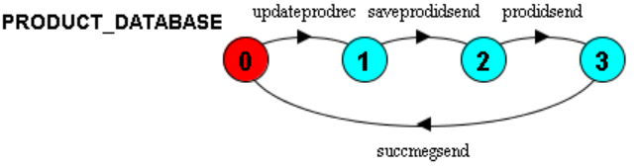
LTS code
3)PRODUCT=(updateprodrec->saveprodidsend->prodidrec->succmegsend->PRODUCT).
DATABASE=(saveprodidrec->prodidsend->DATABASE).
||PRODUCT_DATABASE=(PRODUCT||DATABASE)
/{saveprodidsend/saveprodidrec,prodidsend/prodidrec}.

Slide 9
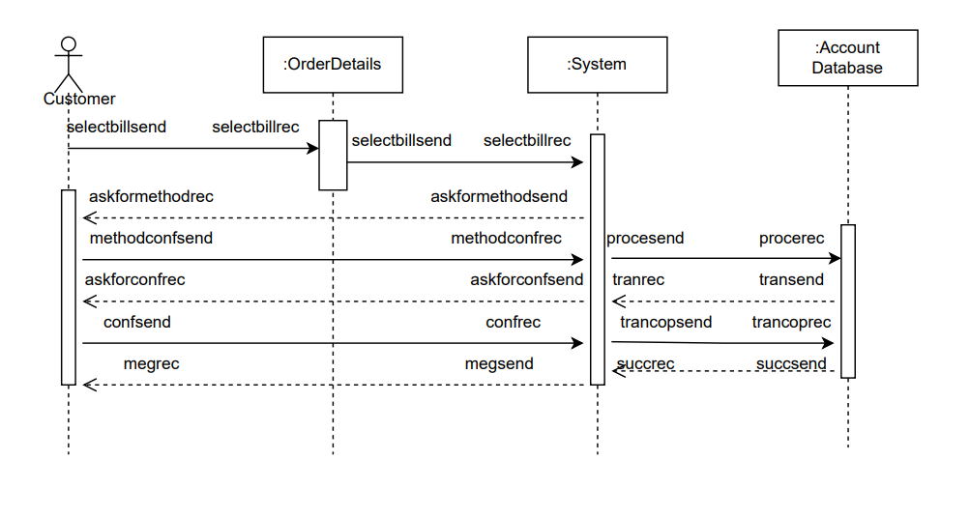
Sequence Diagram
1.2. Make Payment Sequence Diagram (Relabeled):

Slide 10
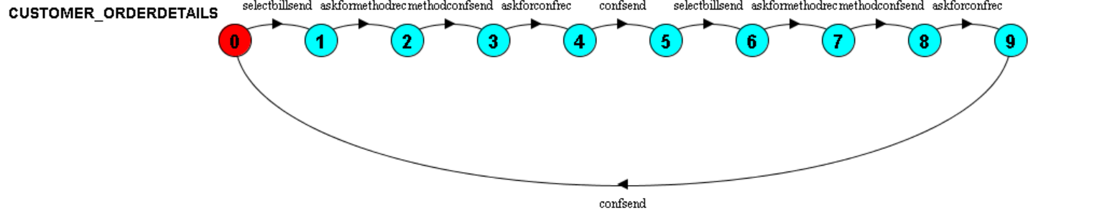
LTS code
1)CUSTOMER =(selectbillsend -> askformethodrec -> methodconfsend -> askforconfrec -> confsend -> CUSTOMER).
ORDERDETAILS =(selectbillrec -> selectbillsend -> ORDERDETAILS).

Slide 11
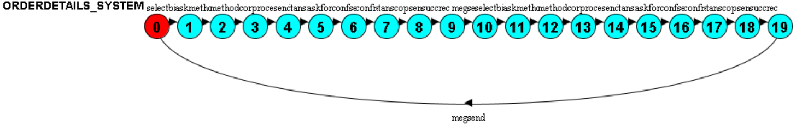
LTS code
||CUSTOMER_ORDERDETAILS =(CUSTOMER||ORDERDETAILS)
/{selectbillsend/selectbillrec}.
2)ORDERDETAILS =(selectbillrec -> selectbillsend -> ORDERDETAILS).
SYSTEM = (selectbillrec -> askmethodsend -> methodconfrec -> procesend -> tansrec -> askforconfsend -> confrec -> tanscopsend -> succrec -> megsend -> SYSTEM).
||ORDERDETAILS_SYSTEM =(ORDERDETAILS||SYSTEM )
/{selectbillsend/selectbillrec}.

Slide 12
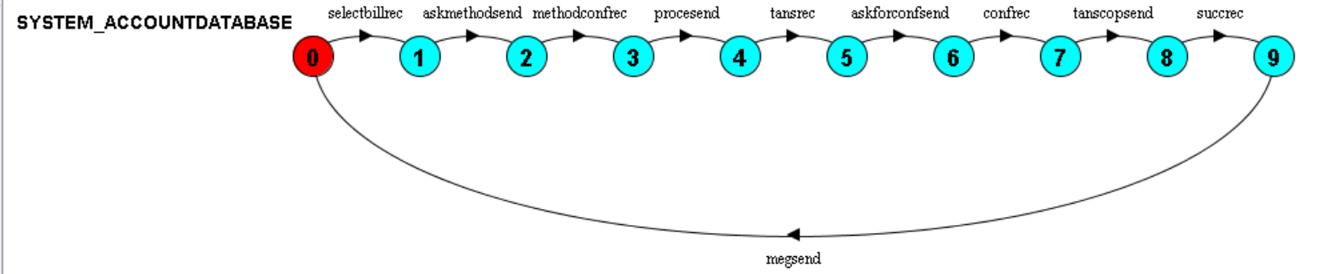
LTS code
3)SYSTEM = (selectbillrec -> askmethodsend -> methodconfrec -> procesend -> tansrec -> askforconfsend -> confrec -> tanscopsend -> succrec -> megsend -> SYSTEM).
ACCOUNTDATABASE = (procerec -> tanssend -> tanscoprec -> seccsend -> ACCOUNTDATABASE).
||SYSTEM_ACCOUNTDATABASE =(SYSTEM||ACCOUNTDATABASE)
/{procesend/procerec,tanscopsend/tanscoprec,succrec/seccsend,tansrec/tanssend}.

Slide 13
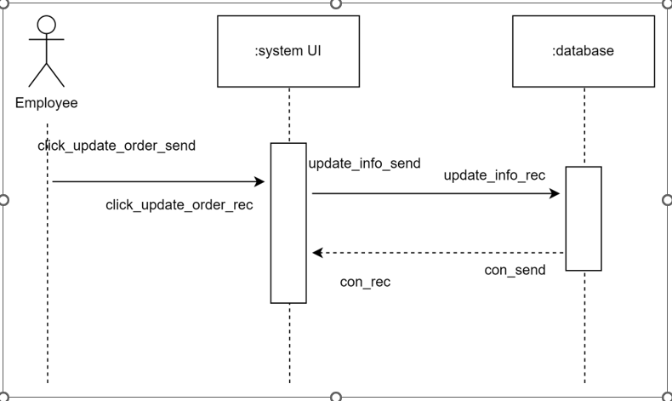
Sequence Diagram
1.3. Manage Order Sequence Diagram (Relabeled):

Slide 14
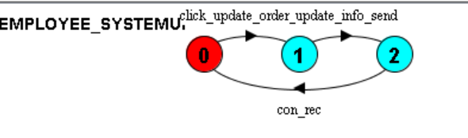
LTS code
1)EMPLOYEE = (click_update_order_send -> EMPLOYEE).
SYSTEMUI = (click_update_order_rec -> update_info_send -> con_rec -> SYSTEMUI).
||EMPLOYEE_SYSTEMUI =(EMPLOYEE||SYSTEMUI)
/{click_update_order_send/click_update_order_rec}.

Slide 15
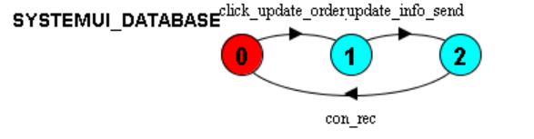
LTS code
2)SYSTEMUI = (click_update_order_rec -> update_info_send -> con_rec -> SYSTEMUI).
DATABASE = (update_info_rec -> con_send -> DATABASE).
||SYSTEMUI_DATABASE =(SYSTEMUI||DATABASE)
/{update_info_send/update_info_rec,con_rec/con_send}.

Slide 16
LTS Description
We relabeled the sequence diagram of the coffee shop management. Then we write the LTS code and execute it. As a result, we got all these figures step by step like admin to system, system to product, product to database, customer to order details, order details to system, system to account database, employee to system, system to database.

Slide 17
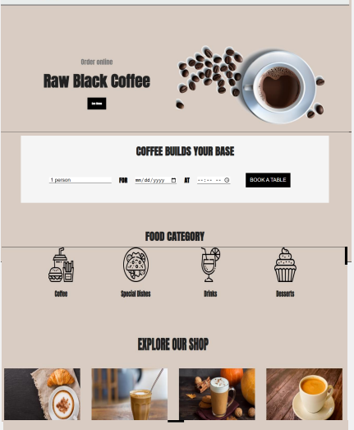
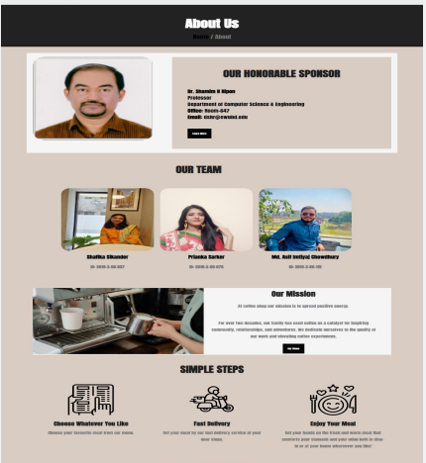
Café Shop Management
Homepage:
About us:

Slide 18
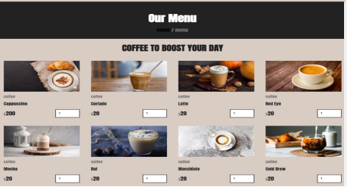
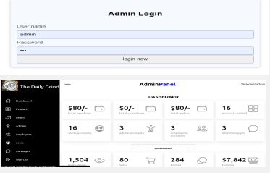
Café Shop Management
Menu:
Admin Panel:

Slide 19
Thank You

